Slide 1
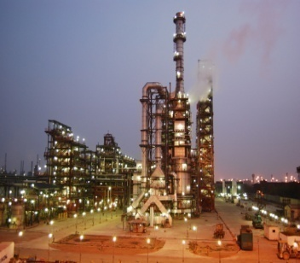
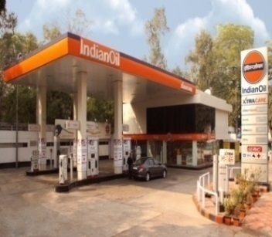
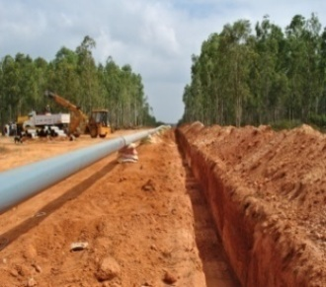
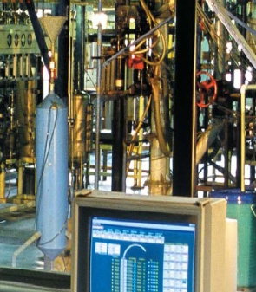
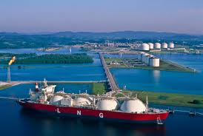
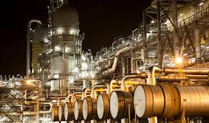

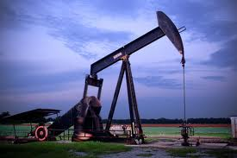
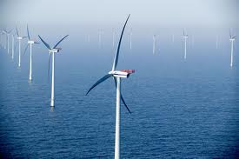
Annual Press
Conference 2013
30.5.2013
New Delhi

Slide 2
Structure of the presentation
Industry synopsis…
At the core of IndianOil…
The year that was…
Open forum…
Performance at a glance…

Slide 3
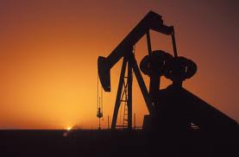
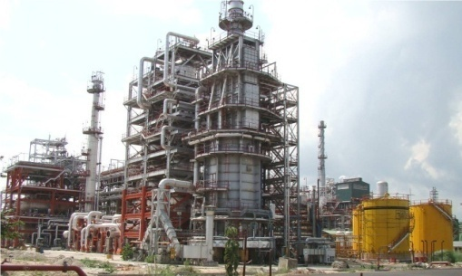
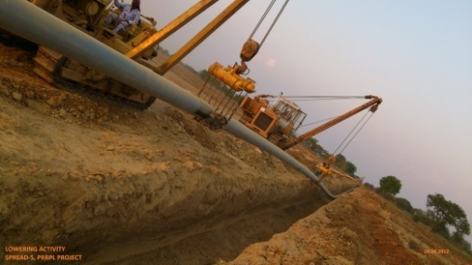

Industry
Synopsis

Slide 4
Economy and oil
Indian economy grows at 5%
POL consumption @ 155.4 MMT in 2012-13 from 148.1 MMT during 2011-12

Slide 5
Indian oil and gas overview
Crude imports (volume) - CAGR 9.2% since 2005-06
  Import dependency about 77% from 76% in 2011-12
  Crude import bill @ USD 144 billion - CAGR 20.6% since 2005-06
Domestic oil production stagnant at ~38 MMT
Gas production declined to 40.7 BCM from 47.6 BCM in 2011-12

Slide 6
Oil dynamics
Av. Indian Crude Basket: USD 108/ bbl
Moderation in Indian crude basket - Average price at USD 108/bbl vs. USD 112/bbl in FY 12

Slide 7
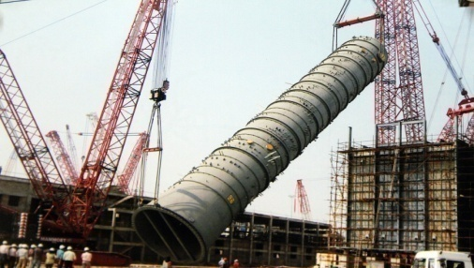
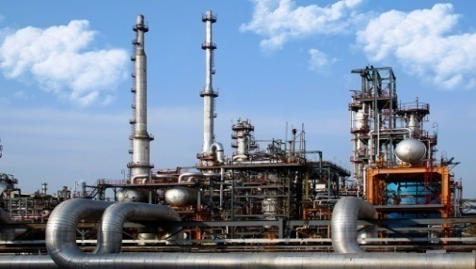
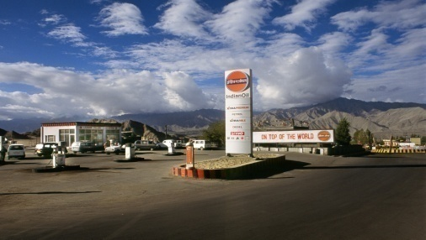
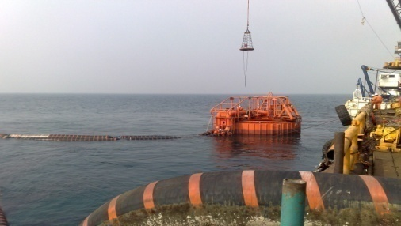
At the core of
IndianOil

Slide 8
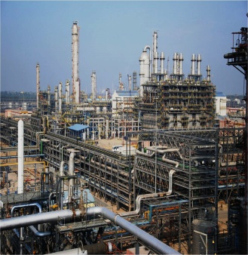
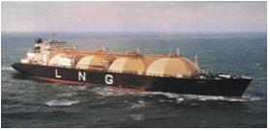
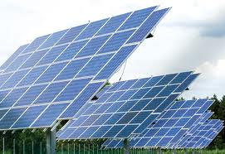
IndianOil – A paragon in the sector
Nation’s largest refiner
* 65.7 MMTPA capacity
* 30.5% of domestic refining capacity
Country-wide network
* Over 11,000 KM crude oil, products & natural gas pipelines
Domestic market leader
* 48.2 % market share
* Over 39,400 touch-points
R&D – among the best
* Pioneer in lube & refining technologies
* New focus on Alternate and Renewable energy
The highest ranked Indian Company in Fortune Global 500, 2012 listing: 83rd rank

Slide 9
IndianOil – A paragon in the sector…
Petrochemicals – moving ahead
* 2nd largest domestic player
* 2.25 MMTPA capacity
Natural gas
* 8.2% domestic market share
* Aggressive infrastructure plans
Exploration & Production
* First-ever revenue from equity oil
* Discovery in three wells
Sustainable development
* 25 MW wind capacity added since last year
The highest ranked Indian Company in Fortune Global 500, 2012 listing: 83rd rank

Slide 10
The year
that was…

Slide 11
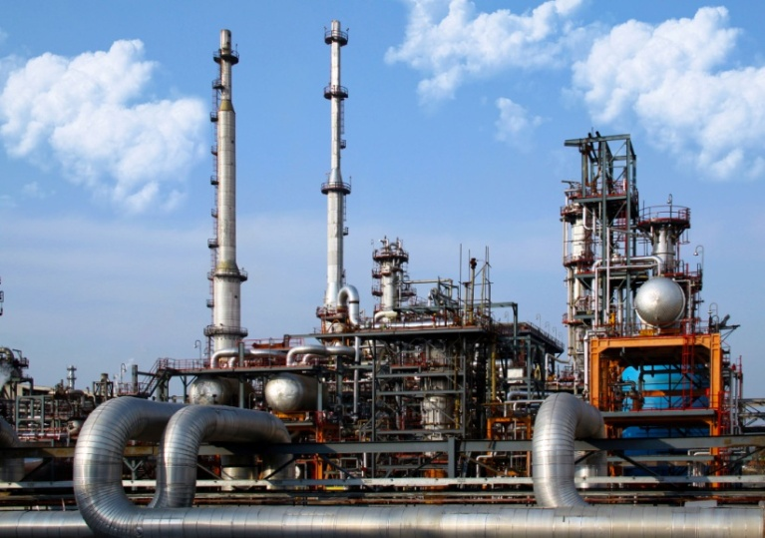
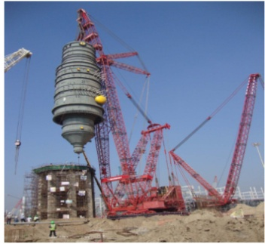
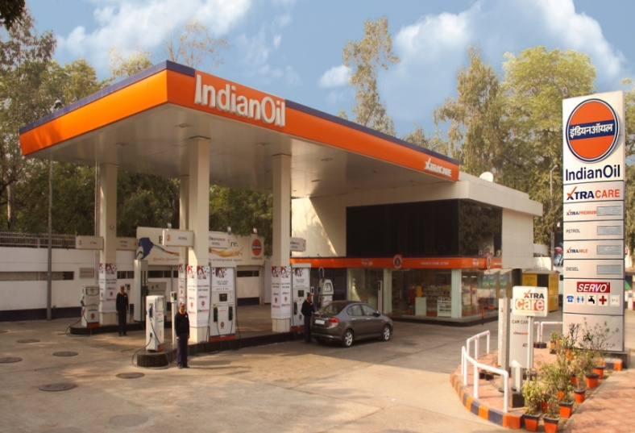
IndianOil – Redefining growth
Over 100% refining capacity utilization, 6th year in a row
Highest-ever turnover of Rs. 4,14,909 crore - a rise of 11% from 2011-12
Bringing energy to rural India –Kisan Sewa Kendras ~ 24% of total RO network
49% of the domestic LPG customer base.
Record 69 lakh new LPG connections in 2012-13
Commissioned Integrated Crude oil Handling Facilities at Paradip

Slide 12
Performance
at a glance

Slide 13
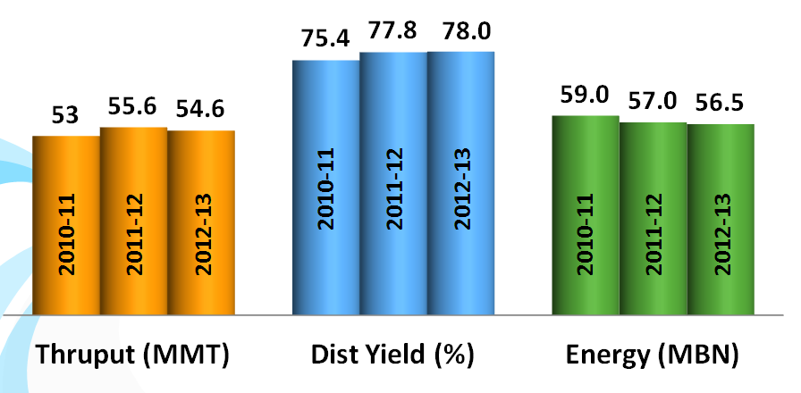
Refineries – Performance par excellence
78.1
56.3
Highest-ever Distillate Yield of 78.1%: Barauni, Panipat and Bongaigaon > 80%
Lowest-ever energy consumption at 56.3: Panipat @ 51, among the best in industry
Panipat – capable of processing 90% HS and 20% Heavy crude

Slide 14
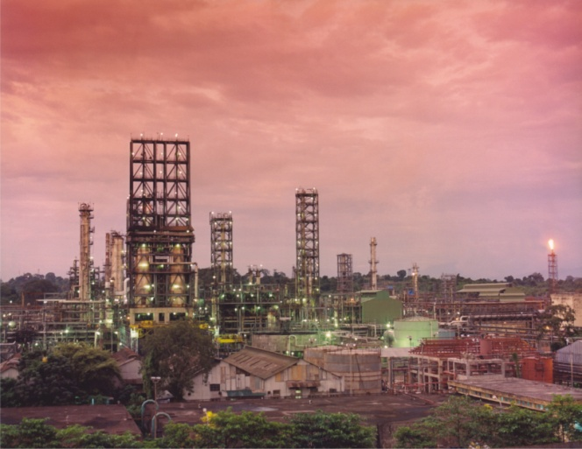
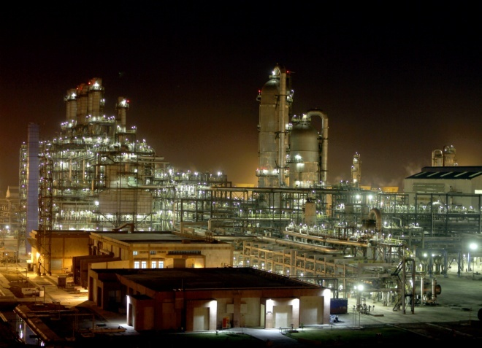
Refineries – Profitability through optimization
Highest HS crude processing at 53.3% from 49.2% in 2011-12
Heavy/ high TAN crude processing @ 13.4%
Crude basket enlarged to 156 crudes
  26 opportunity crudes out of 32 new crudes
  Processed 1.32 MMT Rajasthan crude; 0.99 MMT in 2011-12
  Procured 0.88 MMT Maya crude for the first time – heaviest crude in IndianOil basket

Slide 15

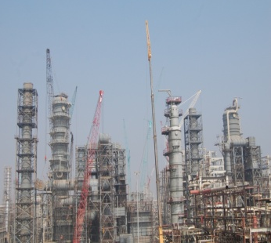
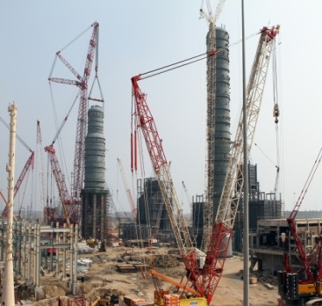
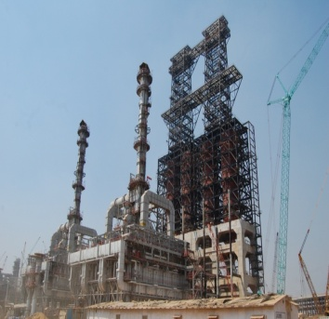
Refineries – Forward agenda
Projects under implementation:
To augment by 2016-17
  Capacity to 74.0 MMTPA from 54.2 MMTPA
  HS crude processing capability to 67% from 53.3%
  Heavy crude processing capability to 21.4% from 13.4%
  Distillate yield to a level of 80.7%
Paradip - State-of-the-art, one of the most modern refineries
  Capable of processing 100% HS including 40% Heavy crude
  Nelson complexity factor – 12.2, comparable to the best in industry
  Distillate yield – 81%, Energy index – 50 MBN

Slide 16
Pipelines – Resplendent networking
Economic transportation – 47% of total white oil products moved through pipelines; 36% by rail, 2% by road & 14% through coastal

Slide 17
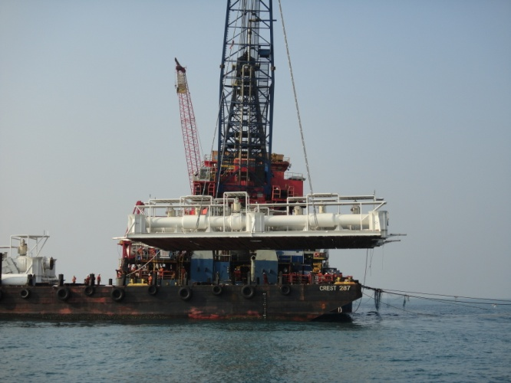
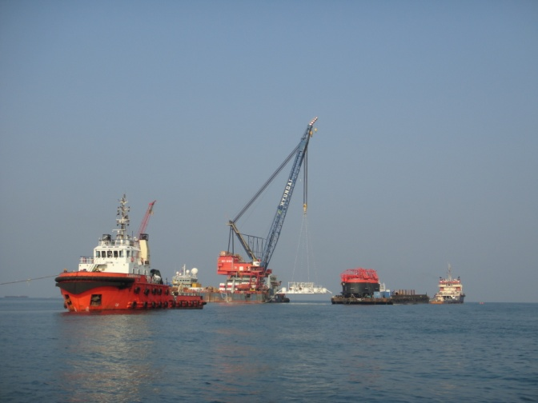
Pipelines – Spreading wings
Two additional SPMs commissioned at Paradip
  5 SPMs in operation - 2 on west coast, 3 on east coast
  Cumulative handling of over 500 MMT crude at Vadinar & over 50 MMT crude at Paradip
Added storage capacity of over 360 TMT for crude oil
Blending facility at Vadinar – ready for commissioning
First customer connectivity through gas pipeline

Slide 18
Pipelines – Forward agenda
Projects over Rs. 6300 crore under implementation
Over 110 MMTPA capacity & 19,000 KM by 2016-17
Enhancement of capability to transport heavy crude
  From 25 cst to 40 cst
  Major Crude oil pipelines
  Debottlenecking of Salaya-Mathura pipeline
  Augmentation of Paradip-Haldia-Barauni Pipeline
  Major Product pipelines
  Paradip Raipur Ranchi Pipeline
  Paradip-Haldia-Durgapur LPG pipeline
  Cauvery Basin Refinery (CPCL) -Trichy pipeline

Slide 19
Domestic growth(%) - Major POL products
Trend in line with economy & prices
Declining growth in LPG due to capping of domestic cylinders

Slide 20
Marketing – Effulgent performance
Highest-ever product sales; Market leader with 48.2% market share

Slide 21
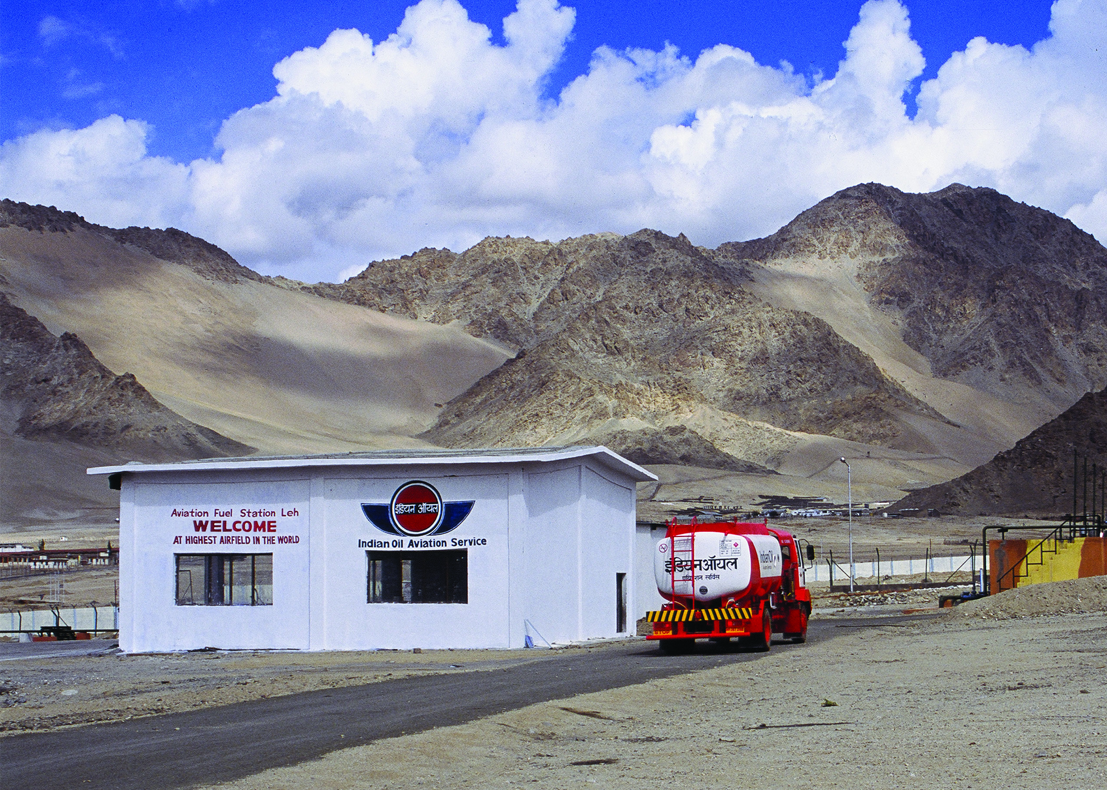
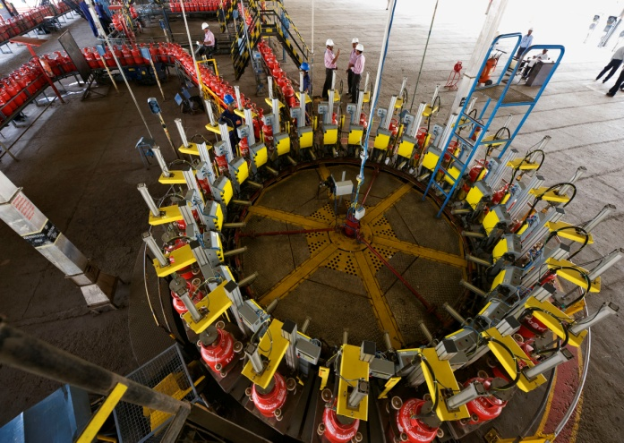
Marketing – Making winning moves
Highest No. of ROs commissioned
  Over 10% sales contributed by KSKs
1600 ROs automated during the year, total reached to 4,377
Commissioned an AFS at Thoise: 10,500 ft. above MSL
Highest-ever supplies of 1 MMT to Nepal
Added over 600 TMTPA of LPG bottling capacity

Slide 22
Marketing – Reaching out, touching lives
As on 31.3.2013
39,460 touch points - 51.7 % of the industry

Slide 23
Marketing – Forward agenda
Major projects under implementation
  LPG facilities and marketing terminal at Paradip
  LPG import facility at Kochi
  Various re-sitement projects for optimal logistics
Dedicated ATF pipelines
Initiatives in retail network
  Automation of 12,000 ROs (all ROs selling more than 100 KL/ Month) by 2016-17
  Introduction of large format ROs at highways

Slide 24
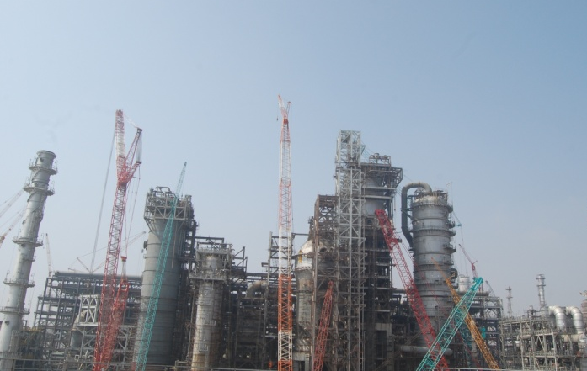
R&D – Class apart
Indigenously developed technologies
  Indmax at Guwahati & Paradip
  LPG Deasphalting process implemented at Haldia
  INDAdeptG being implemented at Guwahati
  Food grade Hexane unit commissioned at HMEL, Bhatinda
  India’s first Integrated lignocellulosic biomass to ethanol pilot plant
  First time co-processing of non-edible oil in DHDT unit of CPCL, Chennai
View of Indigenously developed INDMAX technology at Paradip
Lignocellulosic Biomass to ethanol pilot plant

Slide 25
R&D – Class apart
Lubricants
  120 product formulations developed
  Received 43 OEM/customer/defence approvals & re-certifications
Patents
  Applied record No. of 52 patents in a year: 8 patents granted
Status of patents:
India | USA | Others | Total
133 | 56 | 65 | 254
Lubes | Refineries | Others | Total
35 | 138 | 81 | 254

Slide 26
PROPEL – Ideas for growing business
2nd largest petrochemicals capacity share in the country

Slide 27
Petrochemicals – Forward agenda
Entering into niche segment
  139 TMTPA, Butadiene Extraction Unit at Panipat
  120 TMTPA, Styrene Butadiene Rubber plant at Panipat
Revamp & debottlenecking of existing PX/PTA & LAB units
Poly Propylene unit at Paradip
Petcoke Gasification & Acetic Acid project

Slide 28
Gas – Emerging as the fuel of choice
10%
25%
Highest-ever R-LNG sales

Slide 29
Gas – Emerging as the fuel of choice…
Finalized PMC for Ennore LNG project
Aggressive moves for laying cross-country gas pipelines
Authorized to build CGD networks in Chandigarh & Allahabad
Supplies through ‘LNG at Doorstep’ - growth of 77%

Slide 30
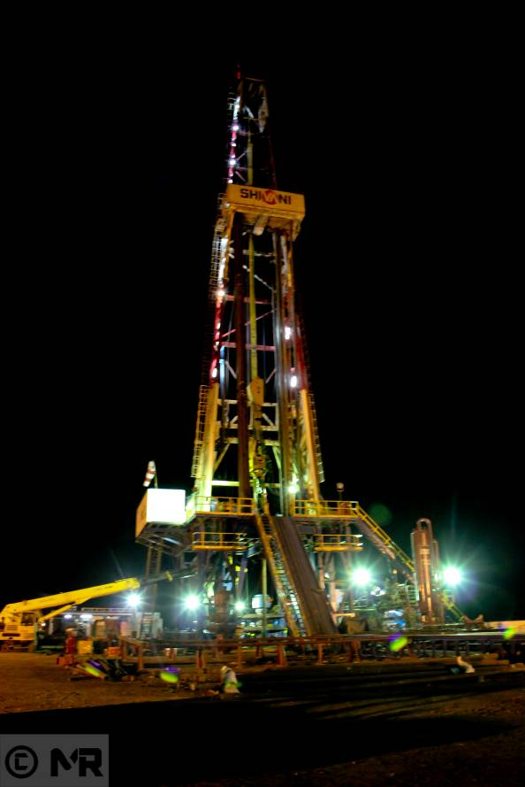
  E&P – A landmark year
  Acquired 10% stake in Niobrara Shale Oil JV asset, Carrizo, USA – brought in 1st E&P earnings
  Production started in Project Carabobo, Venezuela
  1st ever drilling in the domestic operated block
  Discovery in 3 wells
  A view of the drilling site: IOC Khambel 1

Slide 31
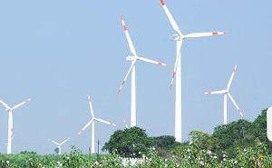
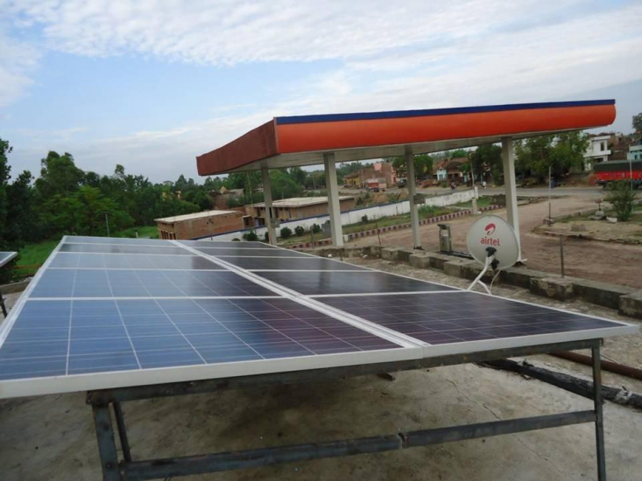
Clean energy – Towards a sustainable future
Wind capacity enhanced to 63 MW
100 GWH grid-connected renewable energy generation in a year
Initiatives towards cleaner tomorrow
  Carbon foot printing at 48 locations
  Energy audit of 28 buildings
  Rain water harvesting at 54 locations
  Solarization of about 300 ROs

Slide 32
CAPEX plans - Investing for a brighter tomorrow
Rs. crore
CAPEX of Rs. 48,655 crore during XI Plan, 7.1% more than plan
Budgeted Estimate (BE) of Rs. 56,200 crore in XII Plan
  Rs. 9378 crore in 2012-13
  BE of Rs. 11,277 crore in 2013-14
Five Year Plans, BE
XII Plan
56,200
XI Plan
45,430
XII Plan CAPEX, Rs. crore | 56,200
E&P | 6,200
Refining & Marketing | 41,456
Petrochemicals | 8,544
X Plan
24,400

Slide 33
Global agenda – Beyond boundaries
Turnover (Rs. crore)
IndianOil Mauritius Ltd.
Lanka IOC Ltd.
Storage, terminaling & retail
157 retail outlets
Aviation, terminaling & retail
24,000 MT storage terminal
18 retail outlets
Bunkering, lube blending & marketing, bitumen
Other overseas subsidiaries:
IOC Middle East FZE – Marketing of Lubricants and POL products
IOC Sweden AB and IOC (USA) Inc: Facilitating overseas upstream operations

Slide 34
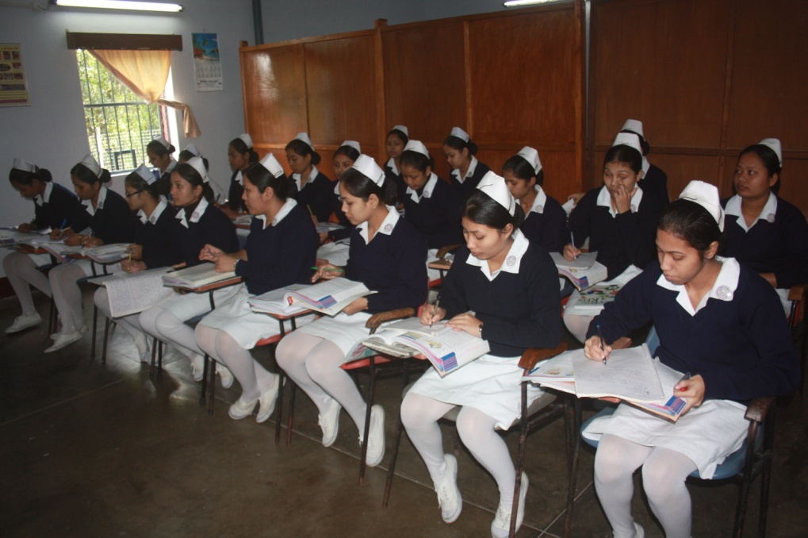
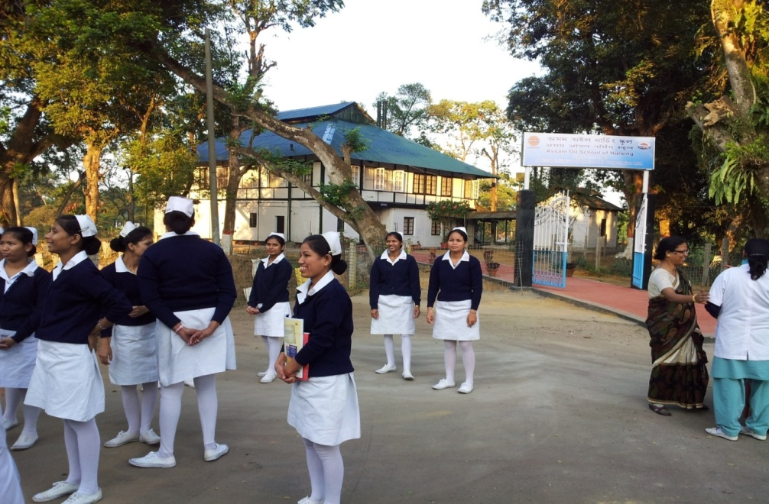
CSR – Making a difference
Assam Oil School of Nursing, Digboi
20 girls successfully completed 4-year nursing course
Cumulatively, 317 girls employed so far (100% success)

Slide 35
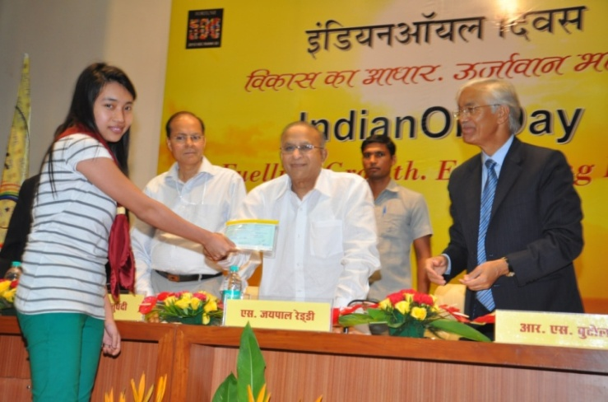
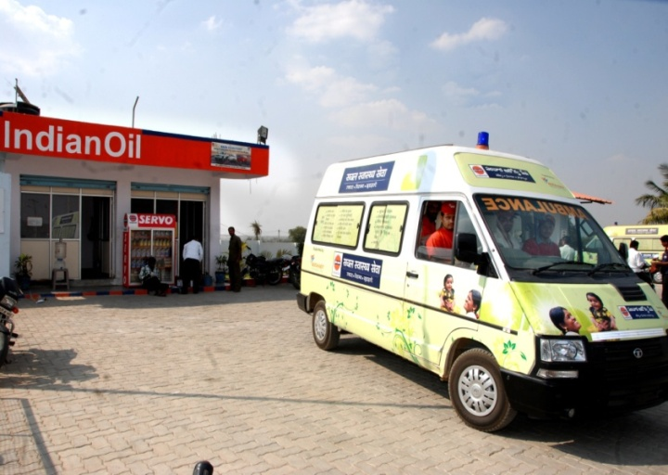


CSR – Extending care and support
2600 educational scholarships
Total cost: Rs. 11 crore in 2012-13
52 Mobile Medical Units operational, linked to 52 Kisan Seva Kendras in AP & UP
Treated over 1 million patients

Slide 36

Financials

Slide 37
Turnover – Marching ahead
(Rs. crore)
Description | 2011-12 | 2012-13 | Var. (%)
Inland sales & exports | 313044 | 344484 | 9.6
Product sales to OMCs | 49255 | 52547 | 16.1
Gas | 4059 | 6263 | 54.3
Petrochemicals | 11889 | 16533 | 39.1
Sub-Total | 378247 | 419827 | 11.0
Less: Discount | 4321 | 4918 | 13.8
Total | 373926 | 414909 | 11.0
11%
Q-4
Q-3
Q-2
Q-1
Quantity Variance Rs 3038 crore and Price Variance of Rs 37945 crore.

Slide 38
Profit after tax

Slide 39
Under-recoveries
(Rs. crore)
 | 2011-12 | 2012-13
Gross Under-Recovery | 75469 | 85793
Less: Compensation
Discount from upstream companies | 29961 | 31967
Budgetary support from Govt. | 45486 | 53278
Total compensation | 75447 | 85245
Unmet Under-Recovery | 22 | 548
% of Unmet Under-Recovery | 0.03% | 0.64%
Loss on MS (Due to non-revision of prices) | 2203 | 485
Total Unmet U/R (including loss on MS) | 2225 | 1033

Slide 40
Borrowings

Slide 41
Contribution to Exchequer
(Rs. crore)

Slide 42
Open Forum

