Slide 1
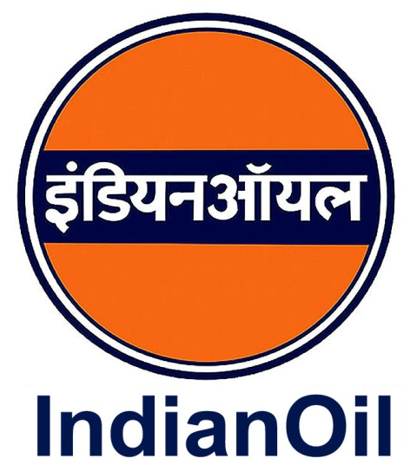
Annual Press Conference 2011-12
28th May 2012
New Delhi

Slide 2
Structure of the Presentation
A glance at oil industry
Overview of IndianOil
Accomplishments
Financials
Open forum

Slide 3
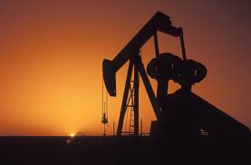
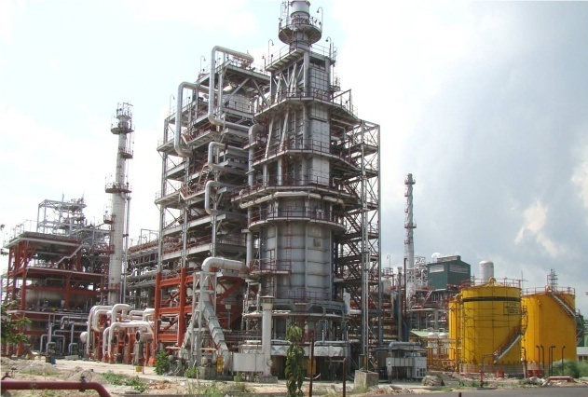
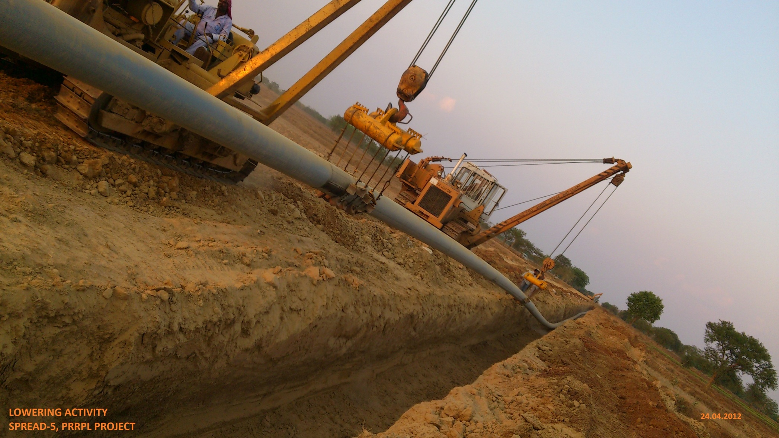
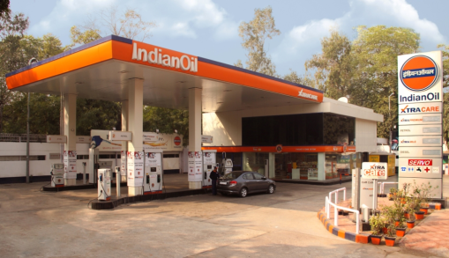
Oil Industry
Synopsis

Slide 4
Oil & Gas Snapshot
US turns net exporter of petroleum products
European economy shows little signs of recovery
Depreciating rupee – a worry for oil importers
Rajasthan crude oil production touches 175,000 bbl/ day
Oil prices remain volatile

Slide 5
Oil & Gas Snapshot
Uncertainties engulf domestic gas output
Domestic refining capacity up by 10 % to 213.2 MMTPA
Domestic POL demand grows by 4.9% over 2010-11
India – 3rd largest Asian LNG buyer in 2011
Crude oil imports @ USD 141 billion, 7.5% of GDP

Slide 6
Oil Dynamics
Crude oil prices, US $/ bbl
Indian crude basket average price moved up by $27/ bbl:
from $ 85/ bbl in 2010-11 to $ 112/bbl in 2011-12

Slide 7
Overview of
IndianOil

Slide 8
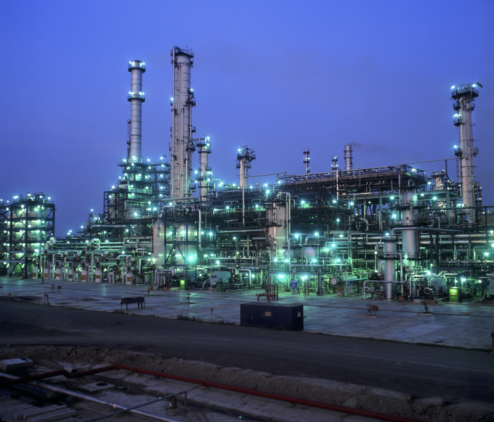
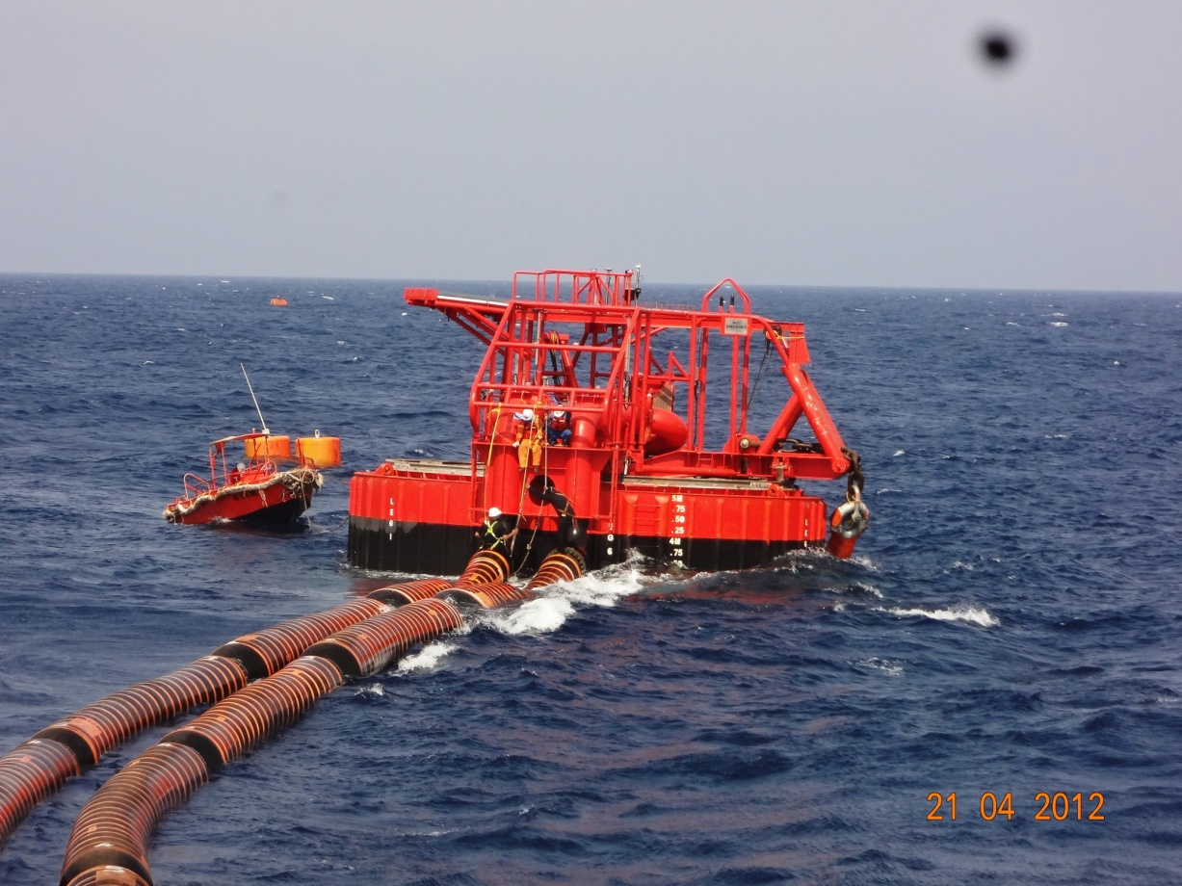
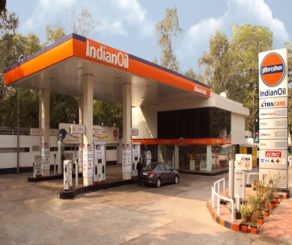
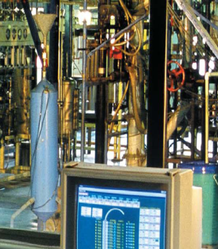
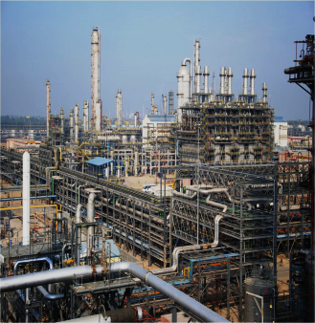
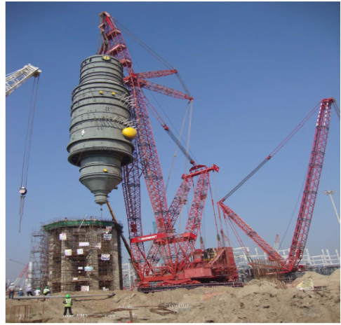
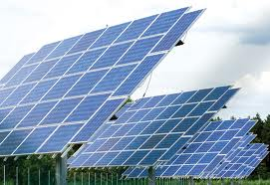
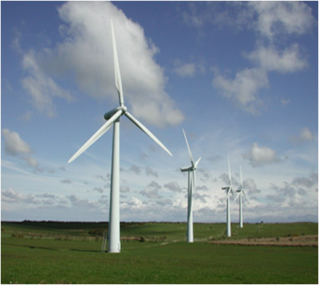
IndianOil – A Degree of Brilliance
Robust marketing network
Petrochemicals – spreading footprints
R&D – among the best
Gas marketing, infrastructure
Renewables, nuclear, upstream ventures
10 group refineries
Crude, products and gas pipelines
Fortune Global 500, 2011 position: 98 - the highest ranked Indian Company

Slide 9
Physical
Performance

Slide 10
IndianOil – Quick Facts
1st Board meeting of the Maharatna Board in March 2012
For the first time turnover surpasses 4,00,000 crore mark (Rs. 409,957 crore)
Domestic sales exceed 70 MMT during 2011-12
7 more cities placed on the Euro-IV map, taking the total to 20
Robust growth plans - ongoing projects worth
Rs. 46,000 crore
Indianoil – The Energy of India

Slide 11
Refineries – Challenging the Limits
5.0%
4.5%
Highest-ever throughput of 55.6 MMT
Over 100% capacity utilization for 5th consecutive year

Slide 12
Refineries – Challenging the Limits
Highest-ever distillate yield of 77.8%
Increasing capacity to process opportunity crudes
Lowest-ever energy consumption of 57 MBN in 2011-12
Commissioned DHDT at Bongaigaon for BS-IV Diesel quality

Slide 13
Pipelines – par Excellence
10.2%
5.5%
Highest-ever throughput of 75.5 MMT

Slide 14
Pipelines – par Excellence
118% capacity utilization for crude oil pipelines
Injection of heavy Rajasthan crude oil
Continuous improvement in energy efficiency
Capacity augmentation:
Chennai-Trichi-Madurai pipeline: from 1.8 to 2.3 MMTPA
Chennai-Bengaluru pipeline: from 1.45 to 2.45 MMTPA

Slide 15
Marketing
Domestic POL Sales
Figs in MMT
% Market Share
Highest-ever petroleum products sales in 2011-12

Slide 16
Marketing – Reaching out, Touching lives
Over 37000 Touch Points, 52% of the industry infrastructure

Slide 17
Marketing – Reaching out, Touching lives
Market leader with 49.7% market share
Retail Outlets network surpasses 20,000 mark
Over 1000 ROs automated during the year
Domestic LPG customer base expanded by 50 lakh, touches 6.68 crore
Aadhar-based LPG pilot launched in Mysore

Slide 18
R & D - Innovating for a Cutting Edge
Commercialization of technologies
‘DHDT and light naphtha isomerisation’ unit commissioned at Bongaigaon
Widening horizons
New petrochemicals and polymers labs
MOU with Department of Bio-Technology (DBT) to set up “Advanced Bio-energy Research Centre”
Commissioned fluidized bed gasification pilot

Slide 19
R & D - Innovating for a Cutting Edge
Lubricants
154 product formulations developed
Two indigenously developed synthetic aviation lubricants granted provisional clearance by CEMILAC
Patents
Six patents granted during the year
Details of active patents:
India | USA | Others | Total
119 | 46 | 50 | 215
Lubes | Refineries | Others | Total
42 | 101 | 72 | 215

Slide 20
PROPEL – Creating Footsteps
2nd largest petrochemicals capacity share in the country

Slide 21
PROPEL – Creating Footsteps
Products profile
IndianOil’s
Relative domestic market share (%)
Polyolefins
Polyethylene
Poly-propylene
Aromatics
PTA
LAB
Glycols
MEG
TEG
DEG

Slide 22
Gas – Fuel of the 21st Century
27%
21%
Highest-ever R-LNG sales in 2011-12

Slide 23
Gas – Fuel of the 21st Century
Increasing share in country’s infrastructure
Pre-project activities in advanced stage for Ennore LNG Terminal
MoU signed with Dhamra Port Company Ltd.
SPVs formed for execution of gas pipeline projects
Upcoming markets
Memorandum of Co-operation with DMICDC

Slide 24
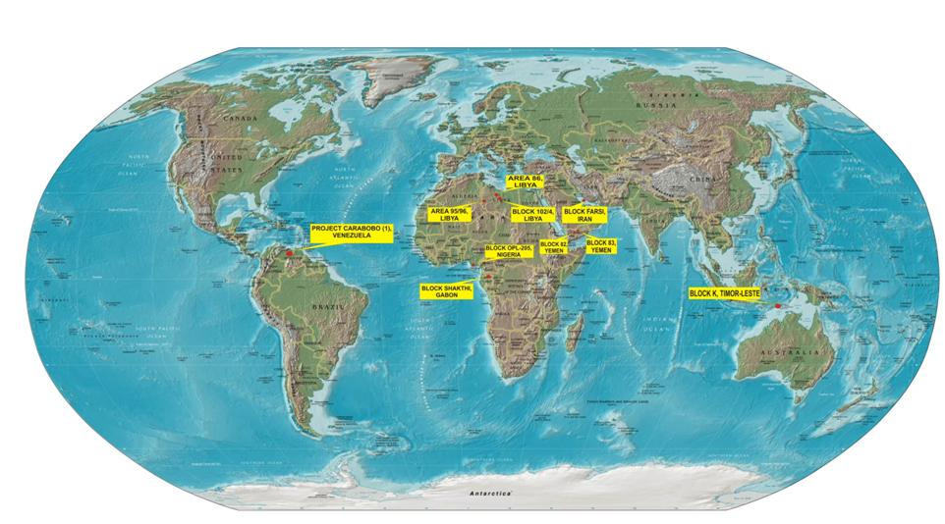
E&P – Overseas Exploration Blocks
Carabobo Project-1, Venezuela
Area 86, Libya
Area 95/96, Libya
Block 102/4, Libya
Farsi, Iran
Block 82, Yemen
Block 83, Yemen
OML 142, Nigeria
Block Shakthi, Gabon

Slide 25
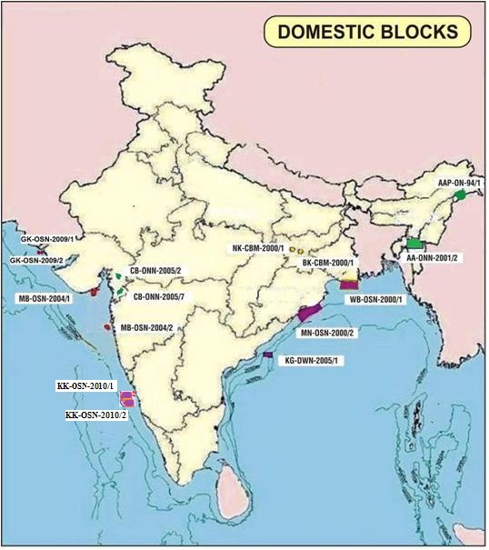
E&P – Domestic Exploration Blocks
GK-OSN-2009/1
GK-OSN-2009/2
AAP-ON-94/1
MB-OSN-2004/1
AA-ONN-2001/2
NK-CBM-2001/1
BK-CBM-2001/1
WB-OSN-2000/1
MB-OSN-2004/2
CB-ONN-2010/6
CB-ONN-2005/2
MN-OSN-2000/2
CB-ONN-2005/7
KG-DWN-2005/1

Slide 26
Clean Energy - The Power of Choice
Grid-connected 5 MW PV solar power plant commissioned in Rajasthan
Wind capacity enhanced to 37.8 MW from 21 MW
Construction started at Rajasthan Atomic Power Project – 7 & 8 : A JV project of IndianOil and NPCIL

Slide 27
Capex Plans - Achievement of a Goal is the Start of a New Road
Five Year Plans
XII Plan
56,200
(Proposed)
X Plan
XI Plan
17,930
45,430
Actual plan Capex during 2011-12: Rs. 11073.5 crore
On-going projects: Rs. 46,000 crore

Slide 28
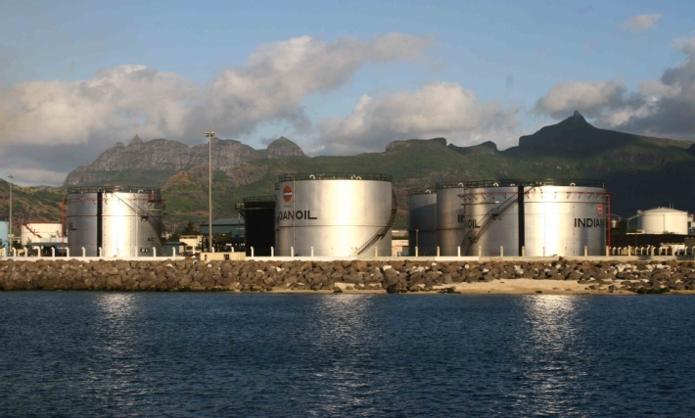
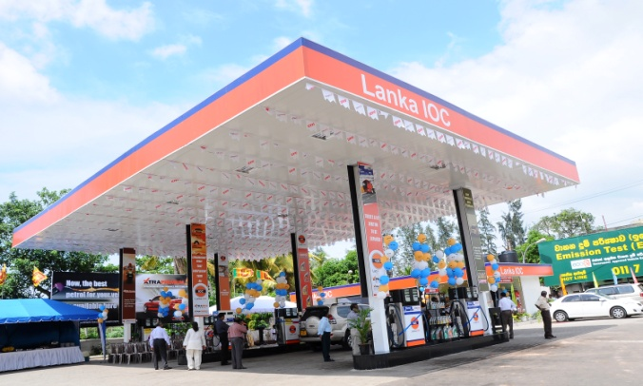
Global Agenda – Leveraging the Core competencies
IndianOil Mauritius Ltd. (IOML)
(100% Stake
Leader in aviation
Lanka IOC Ltd.
(75.1% Stake)
Storage, terminaling and retail business
157 retail outlets
IOC Middle East FZE
(100% Stake)
Marketing of Lubes
Aviation, terminaling and retail

Slide 29
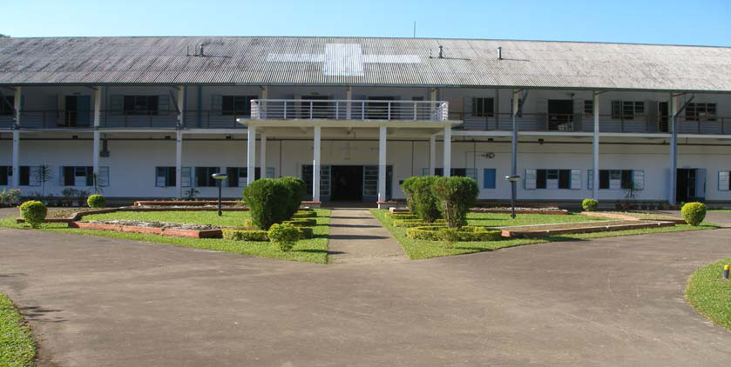
CSR – for Inclusive Growth
CSR Thrust Areas
Drinking water
Health & medical care
Education/scholarships
Sports promotion
National heritage
National causes & natural calamities
LPG schemes

Slide 30
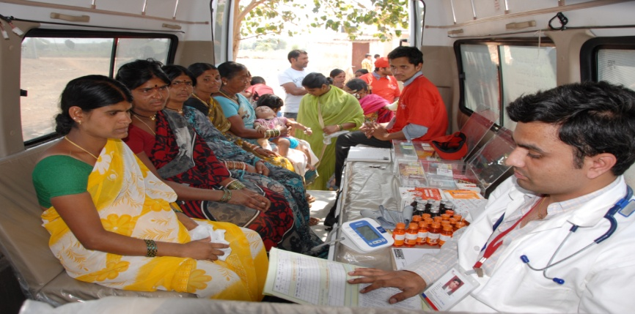
CSR – for Inclusive Growth
New CSR initiatives
IndianOil Sachal Swasthya Seva in AP & UP
IndianOil TATA Care Centre, Kolkata
Development of tourist friendly facilities at Konark and Khajuraho

Slide 31
Financials
Data in finance slides is only indicative

Slide 32
Turnover
4,09,957
25%
3,28,652

Slide 33
Profit…
Attributes, Rs. crore | 2011-12 | 2010-11 | Variance
EBITDA (Before Exceptional item) | 21921 | 16316 | 5605
Less: Exceptional item | 7708 | 0 | (7708)
Interest Expenditure | 5591* | 2673 | (2918)
Depreciation | 4868 | 4547 | (321)
Profit/ (Loss) Before Tax | 3754 | 9096 | (5342)
Tax : Current Tax | 894 | 1356 | 462
Mat credit | 0 | (1286) | (1286)
Deferred Tax | (1095) | 1581 | 2676
Profit/ (Loss) After Tax | 3955 | 7445 | (3490)
* Includes approximate interest on delayed on receipt of cash compensation of Rs. 2800 crore, calculated based on average SBI CC rate
Quarter-wise Profit & Loss, Rs. crore
Year | Q 1 | Q2 | Q3 | Q4 | Total
2011-12 | (3718) | (7485) | 2488 | 12670 | 3955
2010-11 | 5293 | (3388) | 1635 | 3905 | 7445

Slide 34
Under-recoveries
Gross Under-recoveries (Rs. crore) | 2010-11 | 2011-12
SKO (PDS) | 12648 | 17913
HSD | 18673 | 42866
LPG (Domestic) | 10765 | 14690
MS | 1026 | N/A
Total Under-recovery | 43112 | 75469
MS (Post de-regulation) | 1042 | 2236
Grand Total | 44154 | 77705
Product-wise under-recoveries as on 16.5.2012 | Rupees
SKO (PDS)/ litre | 31.41
HSD/ litre | 13.64
LPG (Domestic) per cylinder | 479.00

Slide 35
Under-recoveries
Rs, crore
Under-recoveries 2011-12 | Rs. crore
Gross Under Realization on SKO (PDS), HSD and LPG (Dom) | 75469
Add under-realization on MS, post de-regulation | 2236
Total | 77705
LESS
Discount from Upstream Companies | 29961
Govt. Budgetary Support | 45486
Unmet Under- Recovery / Realization | 2258

Slide 36
Borrowings…

Slide 37
Contribution to Exchequer

Slide 38
Open Forum

Slide 39
Major JV’s
Sl. No. | Name of Major JVs | Ownership Interest of IOC (%) as on 31.03.2012 | Turnover (Rs. crore) |  | Profit after Tax (Rs. crore)
 |  |  | 2011-12 | 2010-11 | 2011-12 | 2010-11
1 | IOT Infrastructure & Energy Services Ltd | 47.97 | 1587.4 | 1187.5 | 111.6 | 110.6
2 | Lubrizol India Pvt. Ltd. | 50.00 | 884.4 | 785.1 | 133.8 | 124.8
3 | IndianOil Petronas Pvt. Ltd | 50.00 | 756.7 | 867.4 | 72.2 | 67.0
4 | Petronet LNG Limited | 12.50 | 22696 | 13197 | 1058 | 620
5 | Green Gas Limited | 25.00 | 116.1 | 96.4 | 23.2 | 16.1
6 | IndianOil Skytanking Ltd. | 33.33 | 339.0 | 269.0 | 10.7 | 7.3
7 | Delhi Aviation Fuel Facility Pvt Ltd | 37.00 | 122.8 | 96.1 | 32.4 | 34.7
Turnover and Profit
Domestic JV’s – 16, Overseas - 1

